Slide 1
ExcelR Solutions
A Project Presentation on
TELECOMMUNICATION CHURN PREDICTION
Presented by
Arunima K
Aswathi Suraj Nair
Dinesh B Sawale
Kushal Hiralal Niveriya
Milind Dattatray Mali
Spoorthy V
Vishal Ramakant Sawant

Slide 2
CONTENTS
BUSINESS OBJECTIVE
DATA SET DETAILS
EXPLORATORY DATA ANALYSIS
OUTLIERS IN DATA
FEATURE ENGINEERING.
MODEL BUIELDING

Slide 3
Business Objective
Customer churn is a big problem for telecommunications companies. Indeed, their annual churn rates are usually higher than 10%. For that reason, they develop strategies to keep as many clients as possible. This is a classification project since the variable to be predicted is binary (churn or loyal customer). The goal here is to model churn probability, conditioned on the customer features.

Slide 4
Data Set Details:
Each row corresponds to a client of a telecommunications company
for whom it has collected information about the type of plan they have
contracted, the minutes they have talked, or the charge they pay every
month.
state: Categorical, for the 51 states and the District of Columbia.
Area.code
account.length: how long the account has been active.
voice.plan: yes or no, voicemail plan.
voice.messages: number of voicemail messages.
intl.plan: yes or no, international plan.
intl.mins: minutes customer used service to make international calls.
intl.calls: total number of international calls.
intl.charge: total international charge.
day.mins: minutes customer used service during the day.
day.calls: total number of calls during the day.
day.charge: total charge during the day.
eve.mins: minutes customer used service during the evening.
eve.calls: total number of calls during the evening.
eve.charge: total charge during the evening.
night.mins: minutes customer used service during the night.
night.calls: total number of calls during the night.
night.charge: total charge during the night.
customer.calls: number of calls to customer service.
churn: Categorical, yes or no. Indicator of whether the customer has left the company (yes or no).

Slide 5
Numerical Data | Categorical Data | Nominal Data | Decision Variable
Voice message | State | Area code | Churn
Intl min | Intl plan
Intl calls | Voice plan
Intl charge
Day min
Day calls
Day charge
Eve min
Eve calls
Eve charge
Night min
Night calls
Night charge
Customer calls

Slide 6
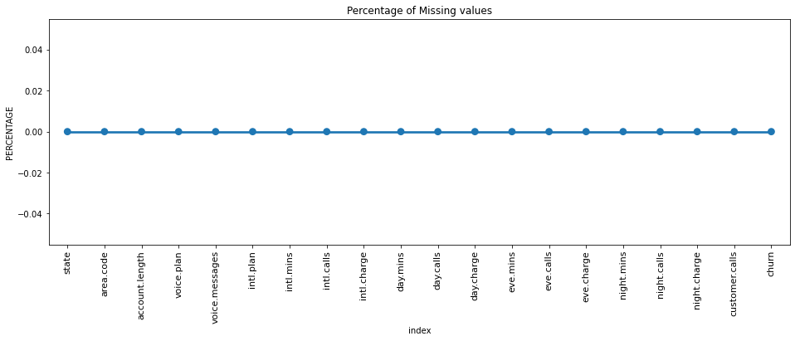
Exploratory Data Analysis
Checking for Missing And Duplicate value :
There are 7 and 24 missing values are there in day.charge
And evening min so we did the missing value imputation.

Slide 7
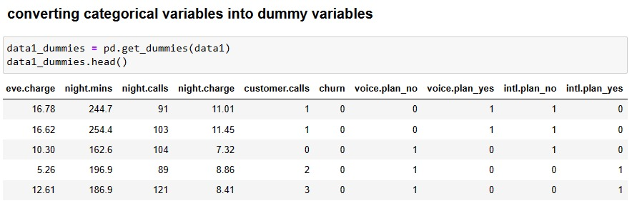
Converting categorical variables into dummy variables

Slide 8
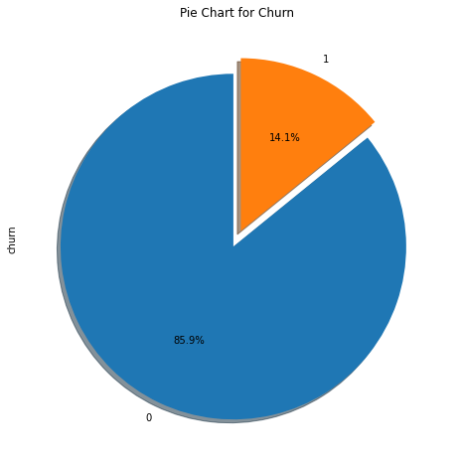
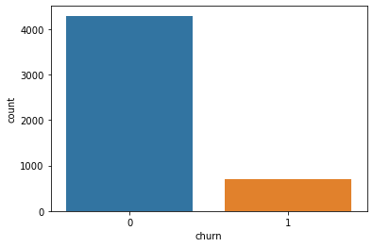
ANALYZING DEPENDENT VARIABLE “CHURN”
Total Customers number - 5000.
Non churn - 4293
Churn - 707
From the above donut plot and count plot, It was found from this analysis that almost 14.1% of customers had churned and 85.9% are not churned .

Slide 9
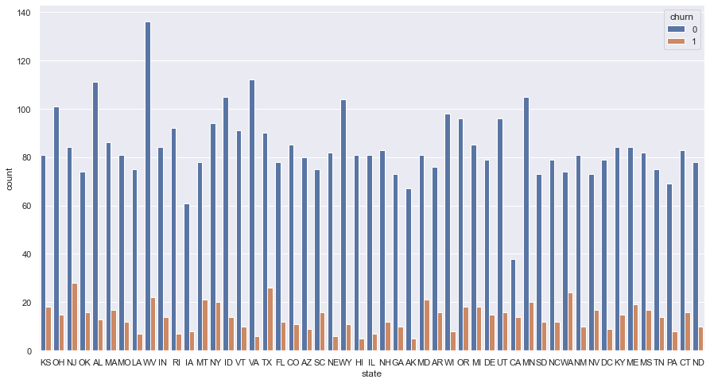
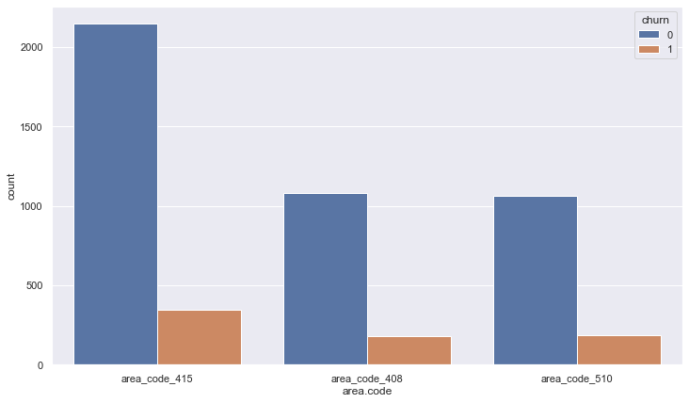
STATE vs. CHURN
AREA CODE vs. CHURN
There is 51 unique state present who have different churn rate. From the above analysis CA, NJ, WA, TX, MT, MD, NV, ME, KS, OK are the ones who have a higher churn rate of more than 21.
In the above data, we notice that there is only 3 unique value are there i.e 408,415,510

Slide 10
STATE and AREA.CODE
By analysing the above plots and data its very difficult to predict churn customer from area code or state.
Both features are independent in nature.
There are no use of this feature for predicting churn customer.
Having no relationship between churn and this features.
So we drop this unused features.

Slide 11
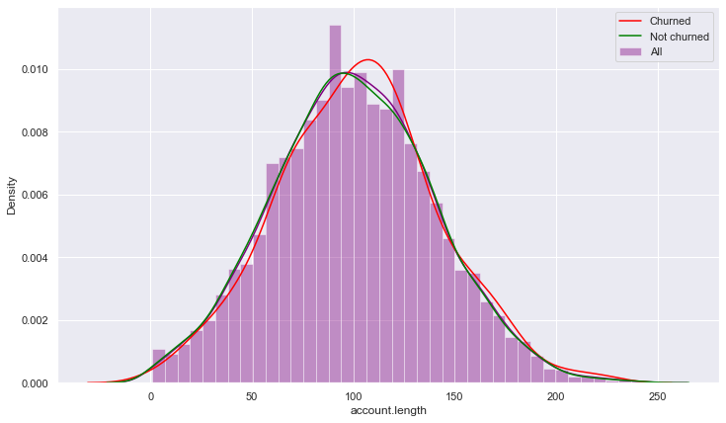
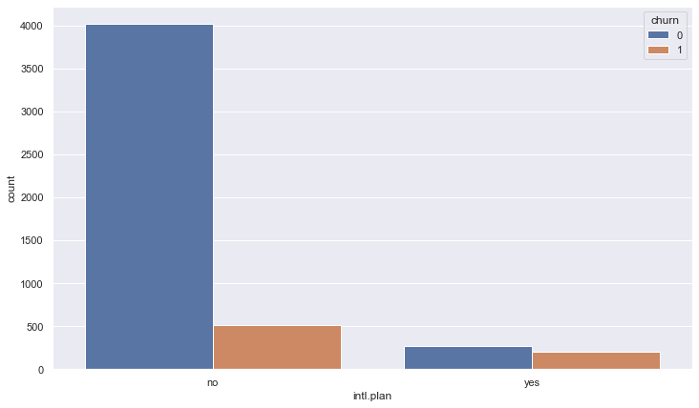
ACCOUNT LENGTH vs. CHURN
INTERNATIONAL PLAN vs. CHURN
After analyzing various aspects of the "account length" column we didn't found any useful relation to churn. so we aren't able to build any connection to the churn as of now. let's see what other features say about the churn
From the above data we get, There are 4527 customers who don’t have a international plan. There are 473 customers who have a international plan. So basically the people who bought International plans are churning in big numbers.

Slide 12
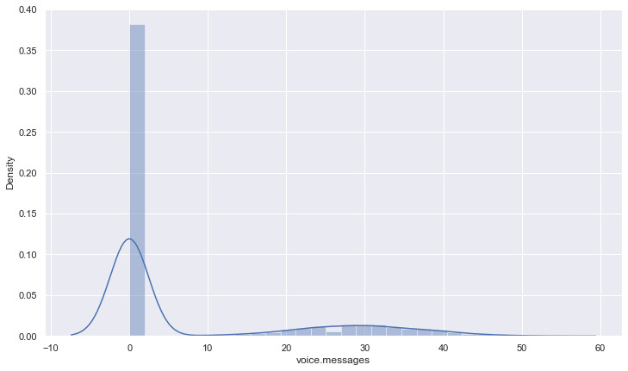
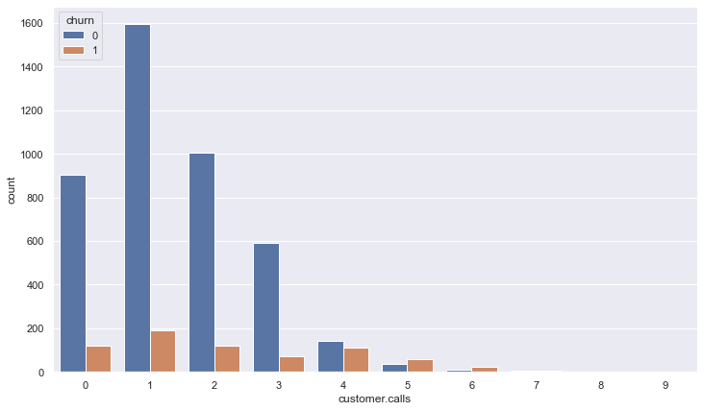
VOICE MESSAGES vs. CHURN
CUSTOMER CALLS vs. CHURN
The above data indicating that those customers who called the service center 5 times or above those customer churn percentage is higher than 60%, and customers who have called once also have a high churn rate indicating their issue was not solved in the first attempt.
After analyzing the above voice message feature data we get an insight that when there are more than 20 voice messages then there is a churn
For that, we need to improve the voice message quality.

Slide 13
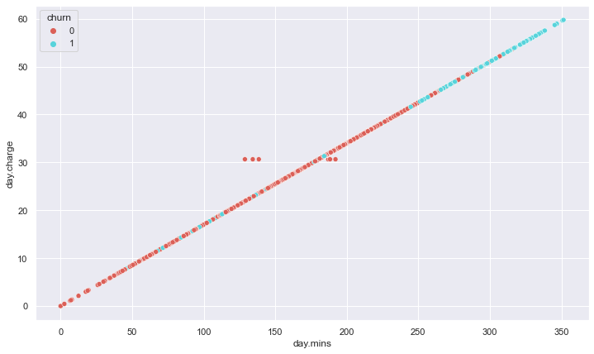
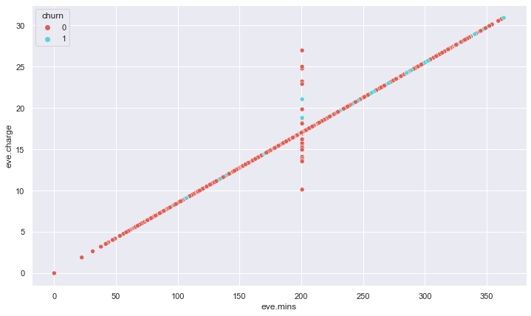
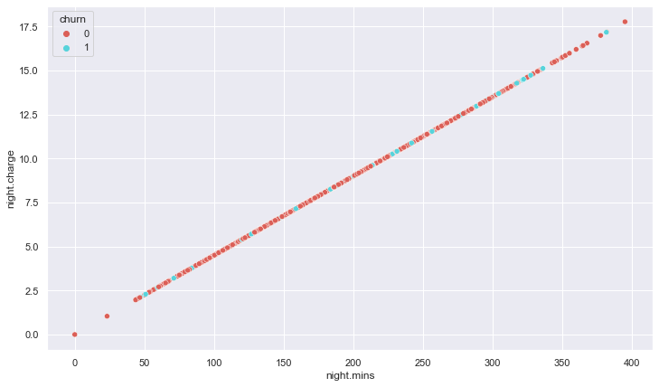
DAY.MIN, DAY.CHARGE vs. CHURN
EVE.MIN, EVE.CHARGE vs. CHURN
NIGHT.MIN, NIGHT.CHARGE vs. CHURN

Slide 14
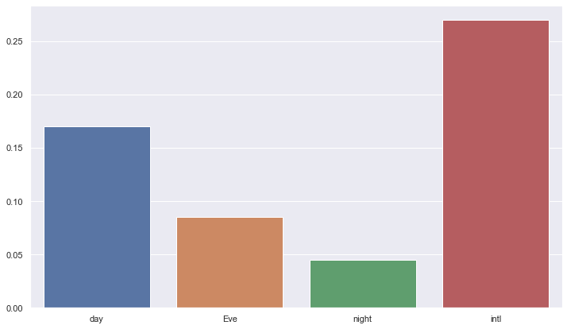
Relation between overall call charge and overall call minutes
we have noticed that total day/night/eve minutes/call/charges are not put any kind of cause for churn rate. But international call charges are high as compare to others it's an obvious thing but that may be a cause for international plan customers to churn out.

Slide 15
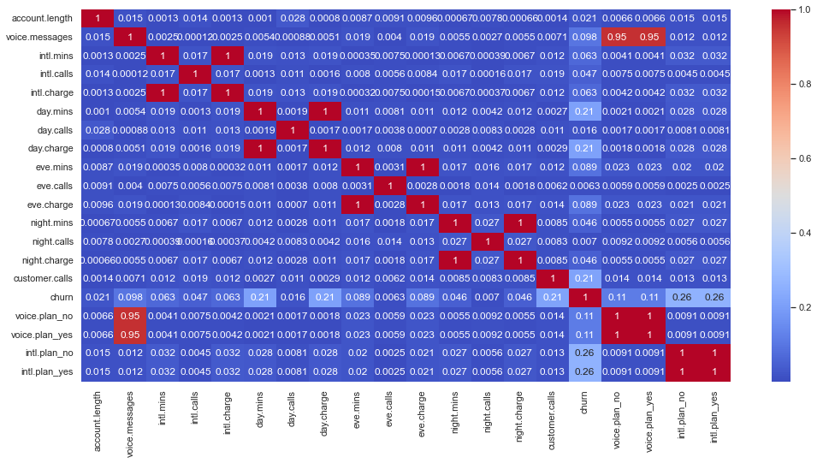
CORRELATION MATRIX

Slide 16
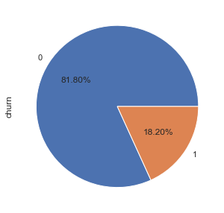
Outliers in Data
Finding outliers in the data.
Dropping categorical data from the outliers dataframe.
Getting the outliers which are greater than or equal to 0.
Later we add churn feature and remove duplicate values.
So,
Non Churn Outliers = 391
Churn Outliers = 87

Slide 17
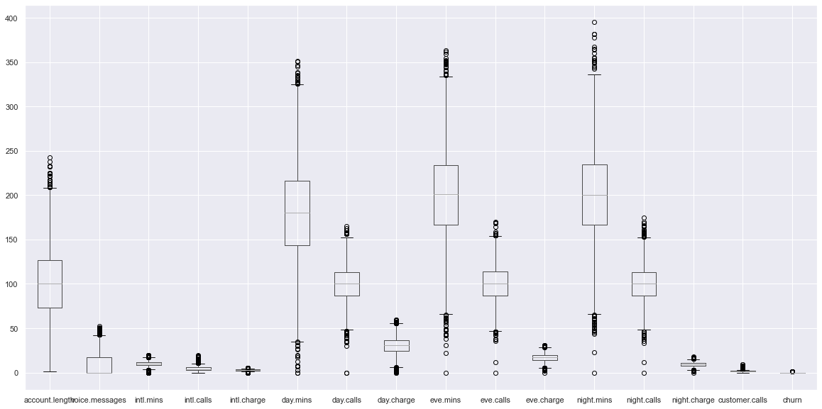
There are 391 customers who are outliers but they are not churns customers and 87 customers are outliers but they are churn customers.
Later we remove not churn customer outliers

Slide 18
Feature Engineering
Process of feature engineering
1.Data selection- collecting required data and breaking down
2.Data preprocessing- cleaning the data and sampling to understand data better
3.Data Transformation-Feature engineering used here
4.Data modelling- creation, evaluation and tuning of models.

Slide 19
Feature engineering techniques:-
Here are the most important feature engineering techniques adopted.
1.Data Imputation
2.Outlier Handling
3.One-hot encoding
4.Data grouping
5.Data scaling

Slide 20
MODEL BUILDING
Applying MinMax Scaler.
Getting x and y variable.
Splitting data into train and test sets.
Building the Logistic Regression, Ridge Classifier, Random forest classifier, Decision tree classifier.
Comparison of Accuracy score of all the applied models.

Slide 21
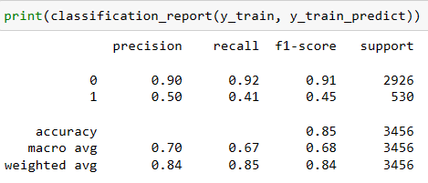
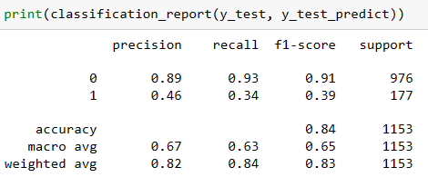
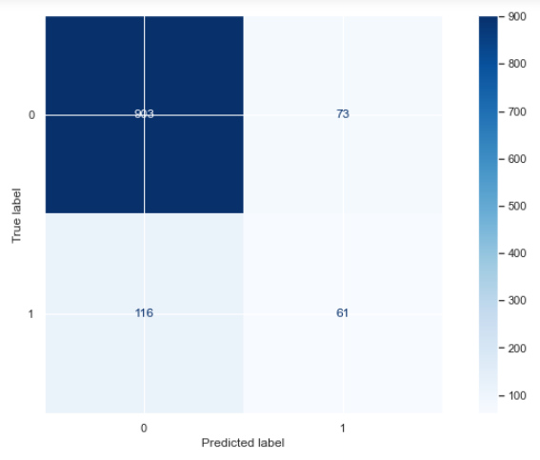
Logistic Regression
Train data
Test data
Confusion Matrix

Slide 22
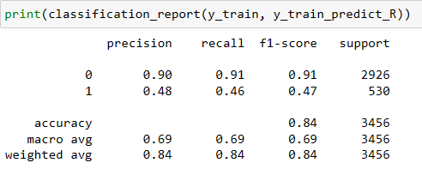
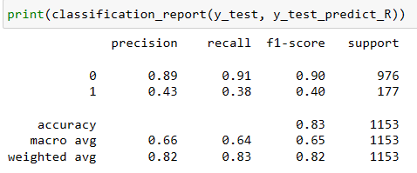
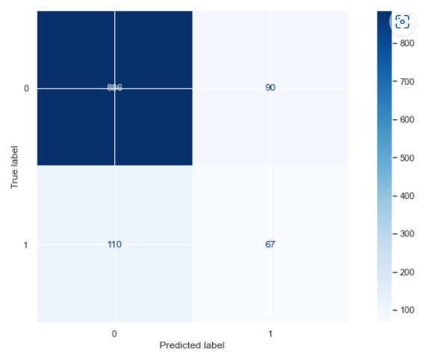
Ridge Classifier
Train data
Test data
Confusion Matrix

Slide 23
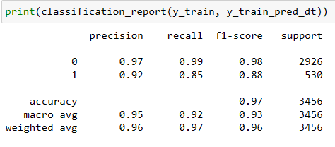
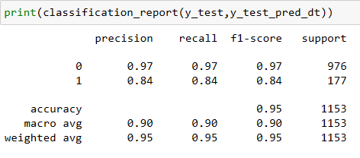
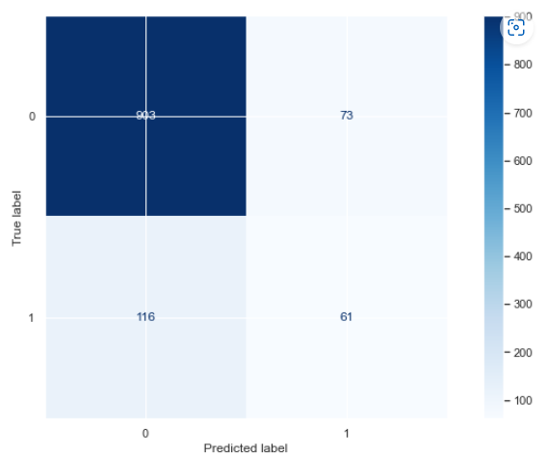
Random Forest Classifier
Train data
Test data
Confusion Matrix

Slide 24
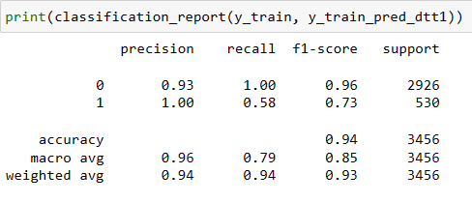
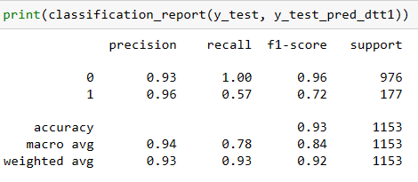
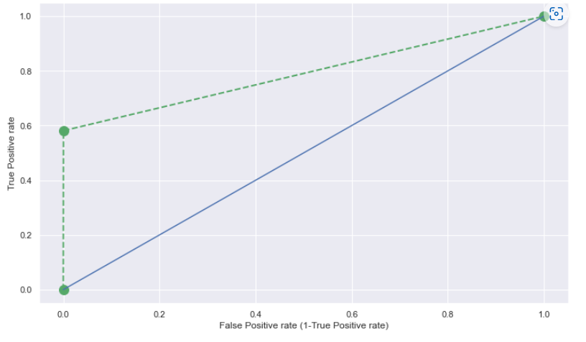
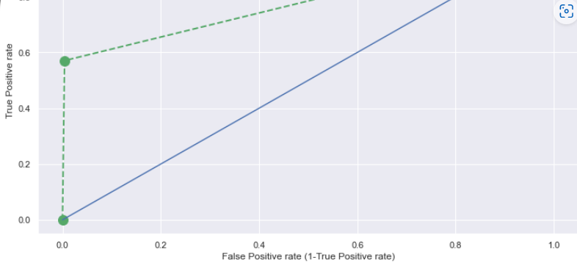
Decision Tree classifier
Train data
Test data

Slide 25
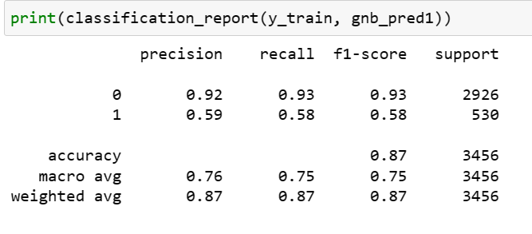
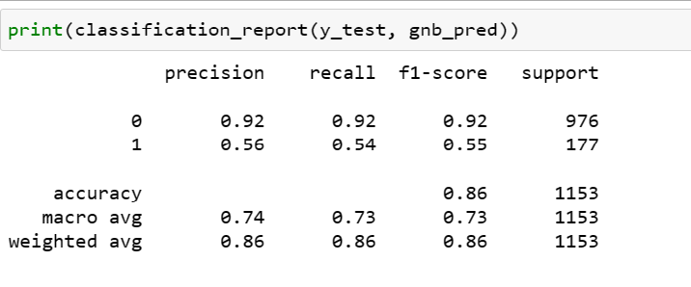
Naïve Bayes
Train data
Test data

Slide 26
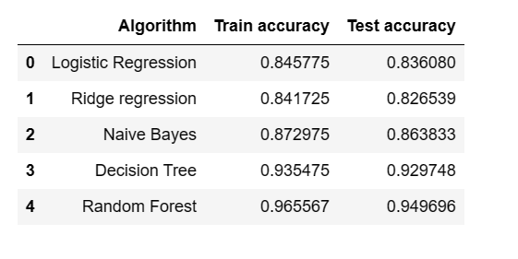
Accuracy score comparison

Slide 27
Imbalanced Data
For balancing the data, we have used
Under Sampling
Oversampling
SMOTE
Class Weights

Slide 28
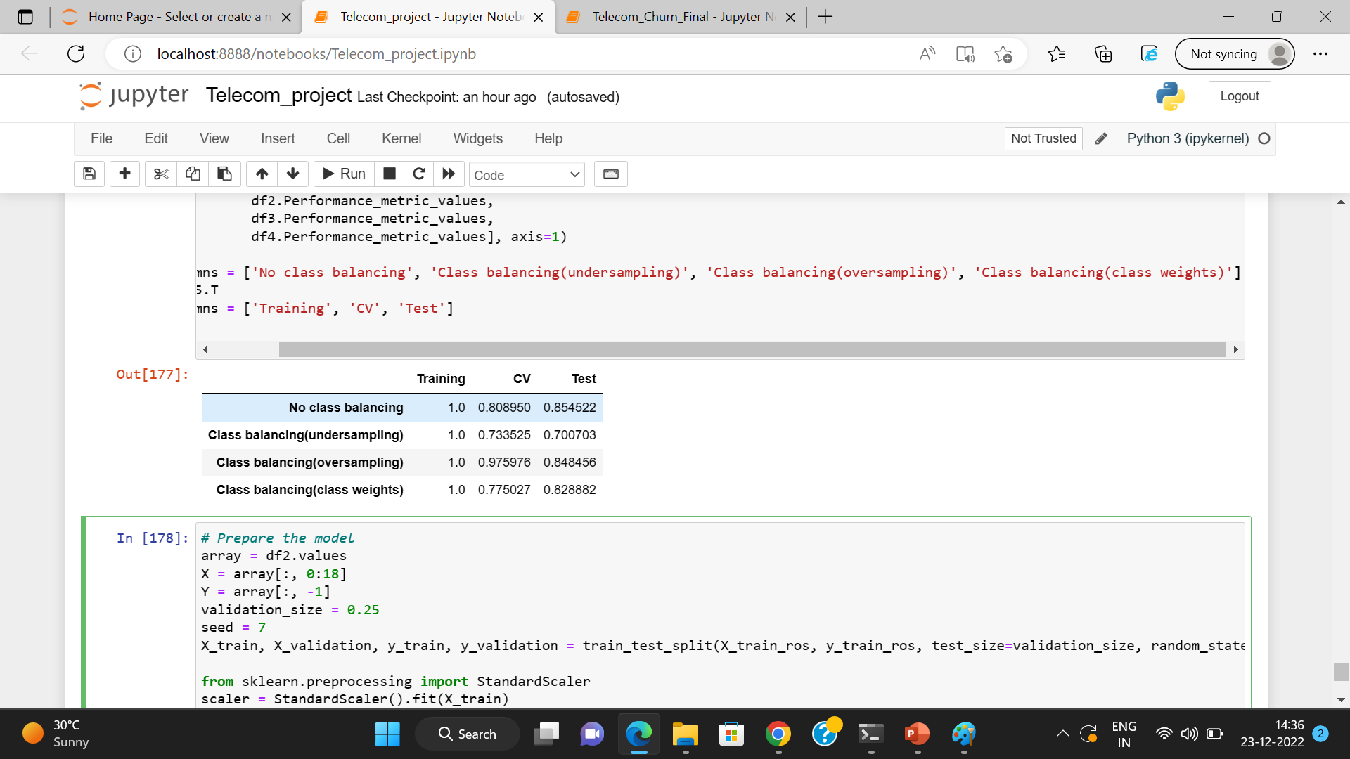
Balanced data Accuracy

Slide 29
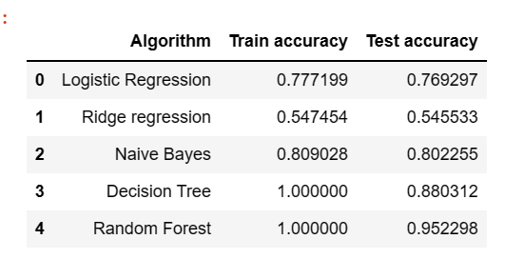
Accuracy after using SMOTE

Slide 30
Conclusion
The model gives its best accuracy when the data is balanced.
But by comparing both the accuracies we have come to conclusion that Random Forest Classifier is the best model from other models.

Slide 31
Deployment
Streamlit is used for deployment of the project.

Slide 32
Thank You…

